Slide 1
SHOP SPHERE
Online Classified Advertisement
and Product Enquiry Platform
Veeramreddy Peta Gnana Prasuna – 99230040450
Marapareddy Harshitha – 99230040661
Karra Prem Sagar – 99230040332
Pacha Venkata Siva Naga Gopi – 99230040700
Lingala Seshanth Reddy – 99230040126
Nushi Purnachandra Reddy – 99230040698

Slide 2
Project Overview
Customer
Seller
Shop
• Browse products
• Search products
• Select a product
• Send an enquiry
• Add products
• Manage listings
• View enquiries
• Contact customers
• Display products
• Update product details
• View enquiries
• Respond to customers
2

Slide 3
Problem Statement
• Customers may find it difficult to identify available products and the correct seller.
• Local sellers and shops need a simple way to display their products online.
• Customers need an easy way to communicate with sellers about a product.
• ShopSphere provides one platform for product discovery and direct enquiries.
3

Slide 4
objectives
Easy Product Search – Help customers easily find and search for products.
User Login – Provide separate login access for users, sellers, and shops.
Product Management – Allow sellers and shops to add, update, and manage their products.
Customer Enquiries – Allow customers to send enquiries about products they are interested in.
Direct Communication – Help customers connect directly with sellers and shops to discuss product details.

Slide 5
User Roles and Login Types
1. User / Customer
Browse and search products.
View product details and images.
Send enquiries to sellers or shops.
2. Seller
Add and manage products.
Update product details and images.
View and respond to customer enquiries.
3. Shop
Display shop products online.
Manage product details and listings.
View and respond to customer enquiries.
6

Slide 6
Proposed Methodology
User Registration & Login – Users, Sellers, and Shops log in using their accounts.
Product Management – Sellers and Shops add and manage their products.
Product Display – Products are displayed on the website for customers.
Product Search – Users browse and search for products.
Send Enquiry – Users send an interest message for the selected product.
Receive Enquiry – Sellers or Shops receive the customer's enquiry.
Direct Communication – Sellers or Shops contact customers to discuss product details.
Product Delivery – They arrange direct delivery or product pickup.

Slide 7
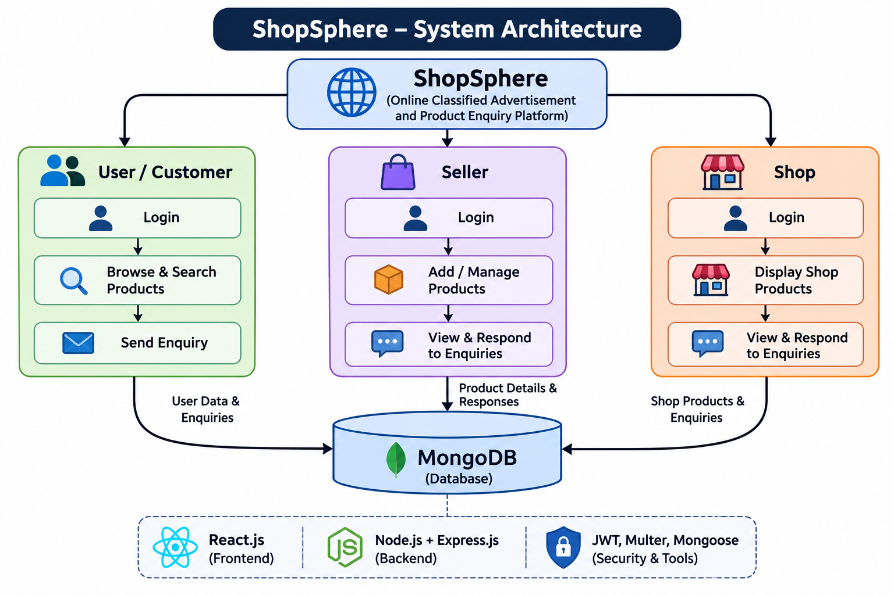
System Architecture

Slide 8
Technologies used
Frontend: React.js, HTML, CSS, JavaScript
Backend: Node.js, Express.js
Database: MongoDB
Authentication: JSON Web Token (JWT)
Password Security: bcrypt
Development Tools: Visual Studio Code
Version Control: Git, GitHub
Deployment: Vercel, Render, MongoDB Atlas

Slide 9
Advantages
Easy to use: Simple and user-friendly interface for customers.
Secure Login: JWT authentication and bcrypt password encryption help protect user accounts.
Fast Product Management: Users can easily view, search, and manage products.
Online Shopping: Customers can browse products and place orders from anywhere.
Centralized Database: MongoDB stores user, product, and order information efficiently.

Slide 10
Future Work
Online Payment: Add payment gateways like Razorpay or Stripe.
AI Recommendations: Suggest products based on the customer's interests and previous purchases.
Chatbot Support: Add an AI chatbot to answer customer queries.
Mobile Application: Develop Android/iOS apps for easier shopping.
Advanced Analytics: Add sales reports and customer behavior analysis.
Delivery Tracking: Allow customers to track their orders in real time.

Slide 11
Conclusion
ShopSphere provides a simple, secure, and convenient online shopping experience. It helps users easily browse products, manage orders, and access product information. The system also provides secure user authentication and efficient data management. Overall, ShopSphere makes online shopping faster, easier, and more user-friendly.

